Slide 1

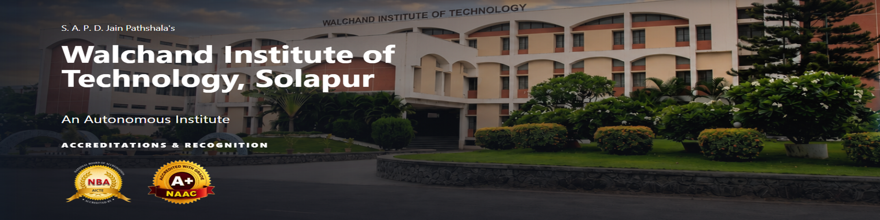
Department of Information Technology
WIT, Solapur
PROJECT SYNOPSIS PRESENTATION
"Design and Evaluation of an Educator-Led Experiential Pedagogical Model and Personalized Digital Platform for Holistic Student Growth"
GROUP NO: | B-07
GUIDE : Dr. Ms. D. D. Awasekar

Slide 2
TEAM DETAILS
Department of Information Technology
WIT, Solapur
"Design and Evaluation of an Educator-Led Experiential Pedagogical Model and Personalized Digital Platform for Holistic Student Growth"
TEAM DETAILS
Sr.
Name of Student
Roll No.
1.
Kabir Shitalkumar Patil
B-26
2.
Alok Shriniwas Perla
B-34
3.
Vidhi Jatinbhai Patel
B-23
4.
Rudraksh Rahul Vaidya
B-61
7/30/2026
EDUCATOR-LED EXPERIENTIAL LEARNING PLATFORM
2

Slide 3
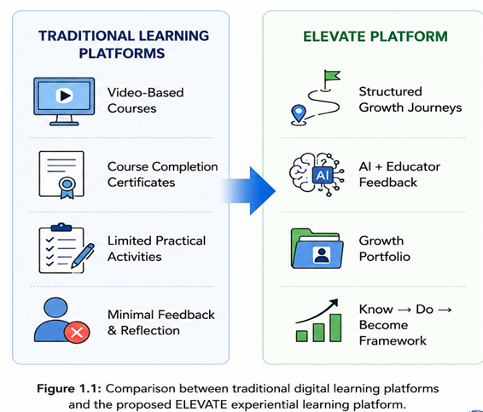
1. Introduction
• Evolution of Digital Learning:
Digital learning platforms have made education more accessible by enabling learners to access courses anytime and anywhere. However, most platforms primarily focus on content delivery rather than competency development.
• Limitation of Existing Platforms:
Current Learning Management Systems (LMS) such as Moodle and online course platforms like Udemy emphasize videos, quizzes, and course completion but provide limited opportunities for experiential learning and continuous feedback.
• Educator-Led Experiential Learning:
ELEVATE introduces a structured learning approach where educators guide learners through practical activities, reflection, validation, and continuous improvement instead of passive content consumption.
• Holistic Student Development:
The platform integrates Growth Journeys, AI-assisted feedback, and Growth Portfolios to support technical, professional, and life-skill development through measurable learning outcomes.
7/30/2026
ELEVATE: EDUCATOR-LED EXPERIENTIAL LEARNING PLATFORM
3

Slide 4
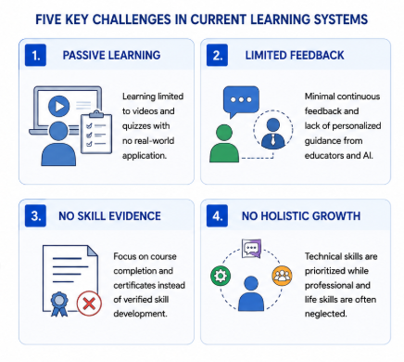
2. Problems Identified
To design and evaluate an educator-led experiential pedagogical model and personalized digital platform that supports life-skill development, professional readiness, and holistic student growth beyond conventional classroom learning.
1. Passive Content-Centric Learning
Learning is often limited to videos and quizzes with minimal practical application or real-world experience.
2. Lack of Structured Experiential Learning
Students have limited opportunities to learn through guided activities, reflection, and hands-on experiences.
3. Limited Personalized Feedback
Most platforms provide generic assessments without continuous mentoring or individualized guidance.
4. Absence of Evidence-Based Skill Assessment
Course completion certificates do not adequately demonstrate practical competencies or learner growth.
5. Poor Support for Holistic Student Development
Technical knowledge is prioritized, while communication, leadership, teamwork, and life skills receive limited attention.
7/30/2026
EDUCATOR-LED EXPERIENTIAL LEARNING PLATFORM
4

Slide 5
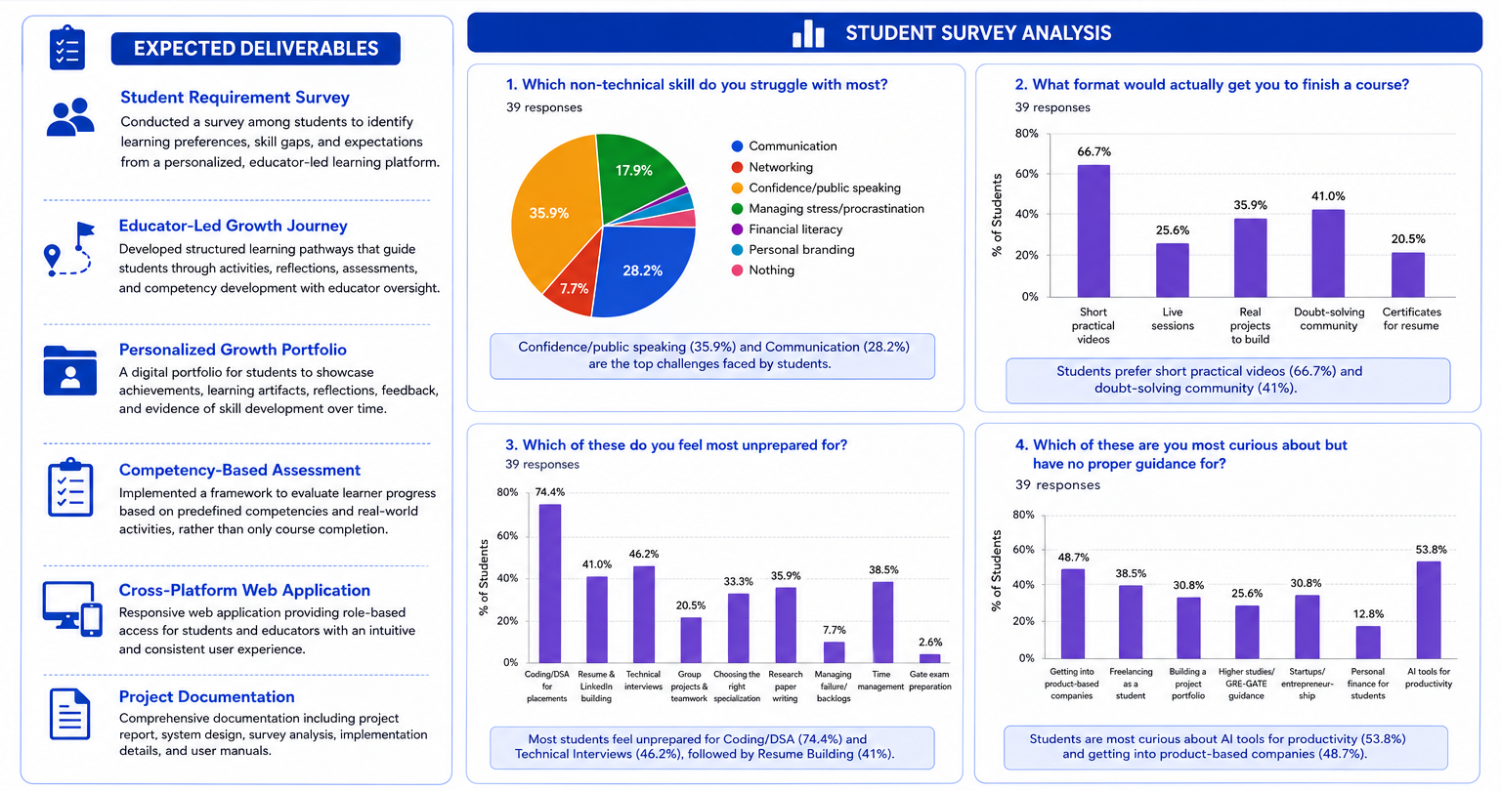
4. Student Learning Survey
7/30/2026
EDUCATOR-LED EXPERIENTIAL LEARNING PLATFORM
9

Slide 6
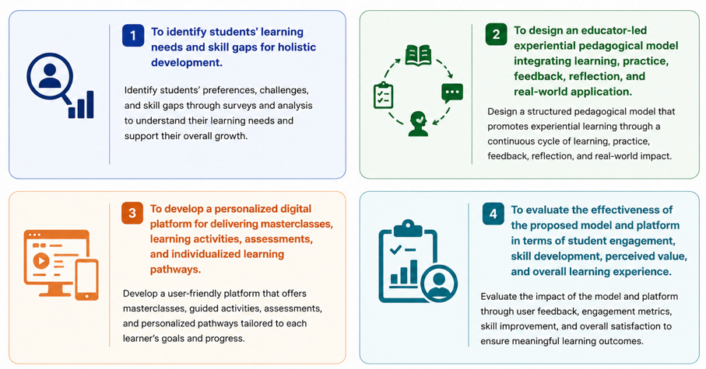
6. Objectives
7/30/2026
EDUCATOR-LED EXPERIENTIAL LEARNING PLATFORM
5

Slide 7
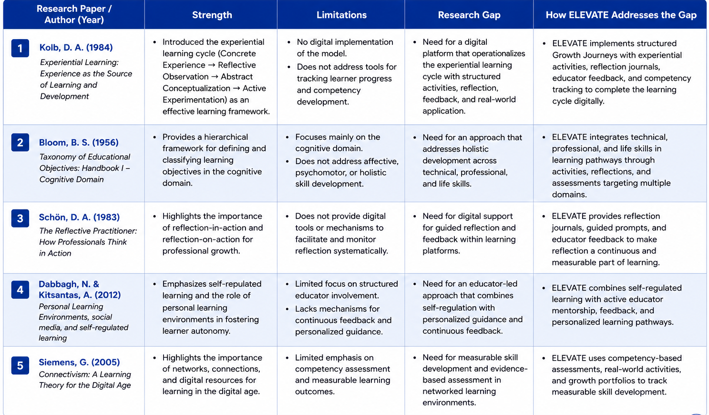
4. Literature Survey
7/30/2026
EDUCATOR-LED EXPERIENTIAL LEARNING PLATFORM
6

Slide 8
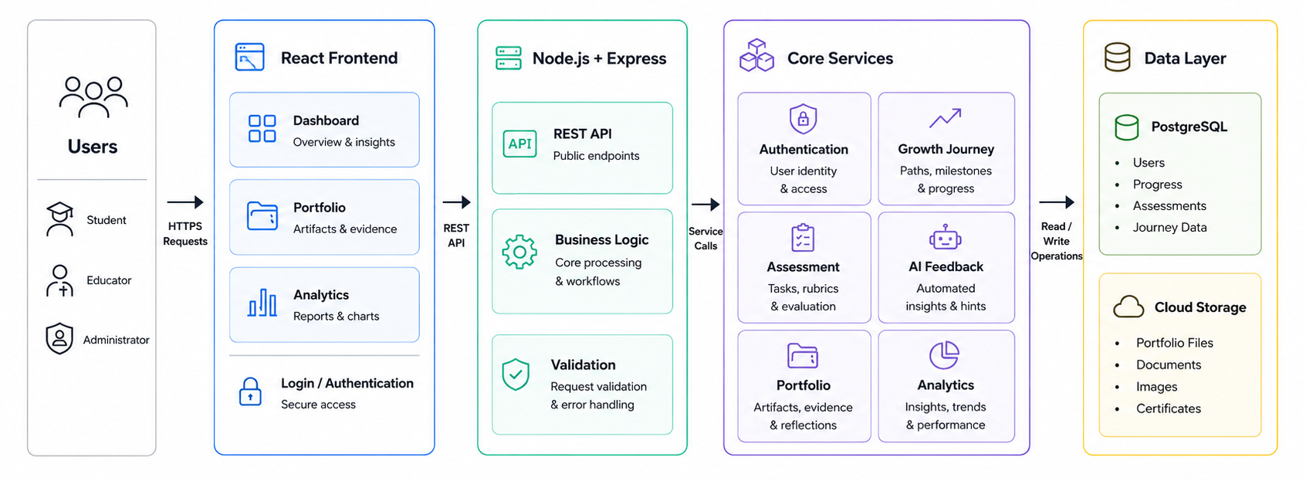
5. Proposed Architecture
7/30/2026
EDUCATOR-LED EXPERIENTIAL LEARNING PLATFORM
7

Slide 9
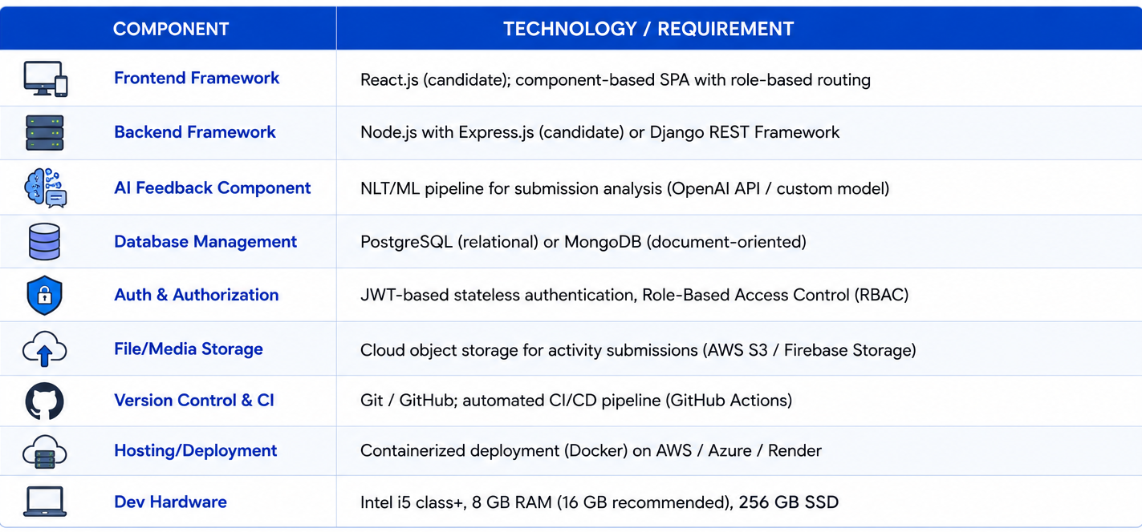
6. Hardware & Software Requirements
Frontend Framework
7/28/2026
EDUCATOR-LED EXPERIENTIAL LEARNING PLATFORM
8

Slide 10
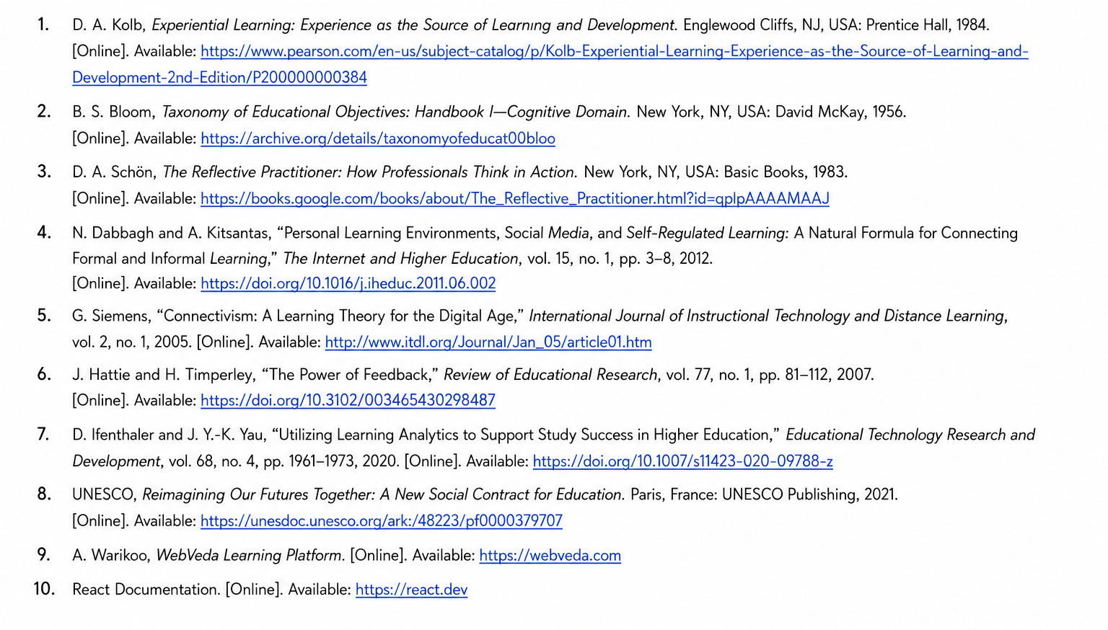
7. References
7/30/2026
EDUCATOR-LED EXPERIENTIAL LEARNING PLATFORM
10

Slide 11
QUESTIONS
7/30/2026
EDUCATOR-LED EXPERIENTIAL LEARNING PLATFORM
11

Slide 12
THANK YOU !
7/30/2026
EDUCATOR-LED EXPERIENTIAL LEARNING PLATFORM
12

